Slide 1

Population Management System – Full Platform Architecture
Comprehensive framework for national population control
Notes:
AI-generated content may be incorrect. --- This presentation provides an in-depth look at the Population Management System designed for Cambodia, covering its architecture, components, and key features to ensure efficient national-level population management. Image source: Microsoft 365 content library

Slide 2

Meeting Program
Project Overview
Frontend Architecture
Backend Architecture
Runtime Data Flows
Component-to-File Mapping
Onboarding Value
Security and Compliance
Performance and Scalability
Integration and Extensibility
Notes:
--- We will begin with an overview of the project objectives and scope, then explore the frontend and backend architectures. Next, we'll examine runtime data flows and component mappings, followed by onboarding benefits, security considerations, performance strategies, and integration capabilities. Image source: Microsoft 365 content library

Slide 3
Project Overview
Notes:
This section introduces the Population Management System designed to enable efficient management of Cambodia's population data, highlighting its purpose, scope, and key objectives focused on accuracy, scalability, security, and bilingual access.

Slide 4

Purpose: Enable Efficient, National-Level Population Management for Cambodia
Unified Population Platform
Creating a centralized system to manage population data efficiently across the entire nation.
Improved Data Accuracy
Enhancing the quality and reliability of population data through integrated validation processes.
Government Accessibility
Ensuring all relevant government departments have easy and secure access to updated population information.
Notes:
--- The primary goal is to provide a unified platform for managing population data at a national scale, improving data accuracy and accessibility across government departments. Image source: Microsoft 365 content library

Slide 5

Scope: Covers Citizen Registration, Updates, and Synchronizations with NCDD
Citizen Registration
The system enables seamless registration of citizens into a centralized database for accurate record keeping.
Record Updates
It supports updating citizen information to maintain current and accurate records over time.
Data Synchronization
The system synchronizes data with NCDD to ensure consistency and integration across national databases.
Notes:
--- The system covers essential functionalities including citizen registration, updates to records, and synchronization with the National Committee for Sub-National Democratic Development (NCDD) to ensure data consistency. Image source: Microsoft 365 content library

Slide 6

Key Objectives: Accuracy, Scalability, Security, and Bilingual Access
System Accuracy
The system is built to provide precise and reliable data outputs for all users.
Scalability to National Demand
Designed to efficiently handle increased user loads across the entire nation without performance loss.
Robust Security Measures
Ensures protection against unauthorized access through strong security protocols.
Bilingual Accessibility
Accessible in both Khmer and English to accommodate diverse user language preferences.
Notes:
--- The system is designed to be accurate, scalable to national demand, secure against unauthorized access, and accessible in both Khmer and English to accommodate all users. Image source: Microsoft 365 content library

Slide 7
Frontend Architecture
Notes:
This section describes the frontend components of the platform including public and registrar portals and emphasizes the bilingual user interface for accessibility.

Slide 8

Next.js Public Site for Citizen-Facing Self-Service
Modern Responsive Interface
The website uses a modern design that adapts seamlessly to desktop and mobile devices for easy citizen access.
Self-Service Features
Citizens can access various self-service options efficiently through the intuitive Next.js powered platform.
Built with Next.js
Next.js framework enables fast, scalable, and SEO-friendly development for the public-facing site.
Notes:
--- The public-facing website, built with Next.js, allows citizens to access self-service features easily and efficiently through a modern, responsive interface. Image source: Microsoft 365 content library

Slide 9

BlazorWasm Registrar Portal Supporting Offline Drafts
Blazor WebAssembly Technology
Blazor WebAssembly powers the registrar portal, enabling rich client-side web applications.
Offline Draft Creation
Users can create and save drafts offline, ensuring work is not interrupted by connectivity issues.
Work Continuity
Offline support ensures continuous productivity even in limited connectivity environments.
Notes:
--- The registrar portal uses Blazor WebAssembly, enabling offline draft creation to ensure continuity of work even when connectivity is limited. Image source: Microsoft 365 content library

Slide 10

Bilingual User Interface for Accessibility
Bilingual Language Support
The interface supports both Khmer and English languages to cater to diverse user groups in Cambodia.
Enhanced Accessibility
Supporting multiple languages improves accessibility and usability for a broader audience.
Notes:
--- The entire frontend supports both Khmer and English languages, ensuring accessibility and usability by a broad range of users across Cambodia. Image source: Microsoft 365 content library

Slide 11
Backend Architecture
Notes:
An overview of the backend infrastructure highlighting multiple technologies handling core business logic, legacy support, synchronization, and role management.

Slide 12

Node.js TSX API for Core Business Logic, JWT Authentication, X-Tenant Support
Core Business Logic
The API uses TypeScript to implement robust and scalable business logic for application workflows and data handling.
JWT Authentication
JSON Web Tokens enable secure and stateless authentication, ensuring safe access to API resources.
Multi-Tenant Support
Supports multiple tenants by isolating data streams, providing tailored experiences within a single API.
Notes:
--- The Node.js API implements core functionalities with TypeScript, leveraging JWT for secure authentication and multi-tenant capabilities to support diverse data sets. Image source: Microsoft 365 content library

Slide 13

PHP 4.x Native for Legacy Integration
Legacy System Support
PHP 4.x backend provides critical support to legacy systems ensuring continuous operation during upgrades.
Seamless Integration
Integration with legacy systems occurs without disruption, maintaining business continuity throughout transition phases.
Notes:
--- Legacy systems are supported through a PHP 4.x backend to ensure ongoing integration without disruption during transition phases. Image source: Microsoft 365 content library

Slide 14

Python 3.12.7 for NCDD Sync, Data Cleaning, PDF Generation
Database Synchronization
Python scripts automate synchronization processes with NCDD databases ensuring data consistency and accuracy.
Data Cleaning
Python handles data cleaning to remove errors and prepare datasets for further analysis or processing.
PDF Generation
Automated PDF generation through Python facilitates reporting and documentation with formatted output.
Notes:
--- Python scripts handle synchronization with NCDD databases, data cleaning processes, and PDF generation for reporting and documentation purposes. Image source: Microsoft 365 content library

Slide 15

BlazorServer API (.NET 10) for Role Management and Real-Time Updates (SignalR)
Role-Based Access Control
BlazorServer API implements role-based access to securely manage user permissions and resources.
Real-Time Updates with SignalR
SignalR enables real-time communication between server and clients for instant updates.
.NET 10 Framework
The API is built on .NET 10, leveraging latest features for scalable and efficient backend services.
Notes:
--- Role-based access and real-time updates are managed through a BlazorServer API built on .NET 10, utilizing SignalR for live communication. Image source: Microsoft 365 content library

Slide 16
Runtime Data Flows
Notes:
Examines how data moves through the system during critical operations such as registrar login, citizen data searches, nightly synchronizations, and secured API access.

Slide 17
Registrar Login and Authentication Process
Secure Login Workflow
The login process ensures secure access by verifying user credentials before granting entry to the system.
JWT Token Utilization
JWT tokens authenticate users and maintain session security throughout system interactions.
Authorization of Access
Access to system resources is authorized based on validated JWT tokens and user roles.
Notes:
--- Details the secure login workflow for registrars, leveraging JWT tokens to authenticate and authorize access to system resources. Image source: Microsoft 365 content library

Slide 18

Citizen Search and Data Retrieval Mechanisms
Efficient Search Methods
Utilize indexing and query optimization to speed up citizen record searches, improving system responsiveness.
Data Retrieval Techniques
Implement reliable retrieval mechanisms to maintain data integrity and accuracy during access to citizen records.
Notes:
--- Describes the methods used to efficiently search and retrieve citizen records, ensuring responsiveness and data integrity. Image source: Microsoft 365 content library

Slide 19

Nightly NCDD Synchronization Pipeline
Automated Nightly Sync
The synchronization process runs automatically each night to ensure data consistency.
Data Synchronization
Local data is synchronized with the NCDD database to maintain updated population records.
Up-to-Date Records
The pipeline ensures population records remain accurate and current through regular updates.
Notes:
--- Explains the automated nightly process that synchronizes local data with NCDD to maintain up-to-date population records. Image source: Microsoft 365 content library

Slide 20

API Gateway with PostgreSQL RLS (Row-Level Security) Enforcement
API Gateway Security
The API gateway acts as a control point to enforce security policies before database access.
PostgreSQL Row-Level Security
PostgreSQL RLS restricts data access at the row level based on user roles and permissions.
Role-Based Data Protection
Access to sensitive data is controlled dynamically according to the user’s assigned role.
Notes:
--- The API gateway enforces security policies at the database level using PostgreSQL's row-level security to protect sensitive data based on user roles. Image source: Microsoft 365 content library

Slide 21
Component-to-File Mapping
Notes:
Outlines the organization of code files and folders across frontend and backend stacks for clarity and maintainability.

Slide 22

Frontend: Key File Paths in Next.js and BlazorWasm Folders
Next.js Directory Structure
Highlights the main folders and files within the Next.js public site project essential for frontend development.
BlazorWasm Folder Overview
Depicts the core folder organization and file locations in the BlazorWasm registrar portal frontend project.
Notes:
--- Shows the main directory structures and important file locations within the Next.js public site and BlazorWasm registrar portal projects. Image source: Microsoft 365 content library

Slide 23

Backend: Node.js TSX, Python, PHP, .NET 10 File Structures
Modular Folder Organization
Backend components are organized into modular folders to streamline development and maintenance.
Multi-language Support
Supports backend development using Node.js TSX, Python, PHP, and .NET for diverse technology stacks.
File Structuring Best Practices
File structures follow best practices for clarity, scalability, and maintainability across languages.
Notes:
--- Details the folder and file organization for backend components implemented in Node.js, Python, PHP, and .NET to support modular development. Image source: Microsoft 365 content library

Slide 24

Documentation for Stack-Specific Grouping
Tailored Documentation Approach
Documentation is customized for each technology stack to ensure relevance and clarity for developers.
Facilitate Onboarding
Clear guidelines help new team members quickly understand and adopt the technology stacks.
Simplify Maintenance
Consistent documentation supports easier maintenance and updates across technology stacks.
Notes:
--- Provides references and guidelines for the documentation approach aligned with each technology stack to facilitate onboarding and maintenance. Image source: Microsoft 365 content library

Slide 25
Onboarding Value
Notes:
Discusses how the platform's unified architecture simplifies onboarding, reduces ramp-up time, and enhances maintainability and security.

Slide 26
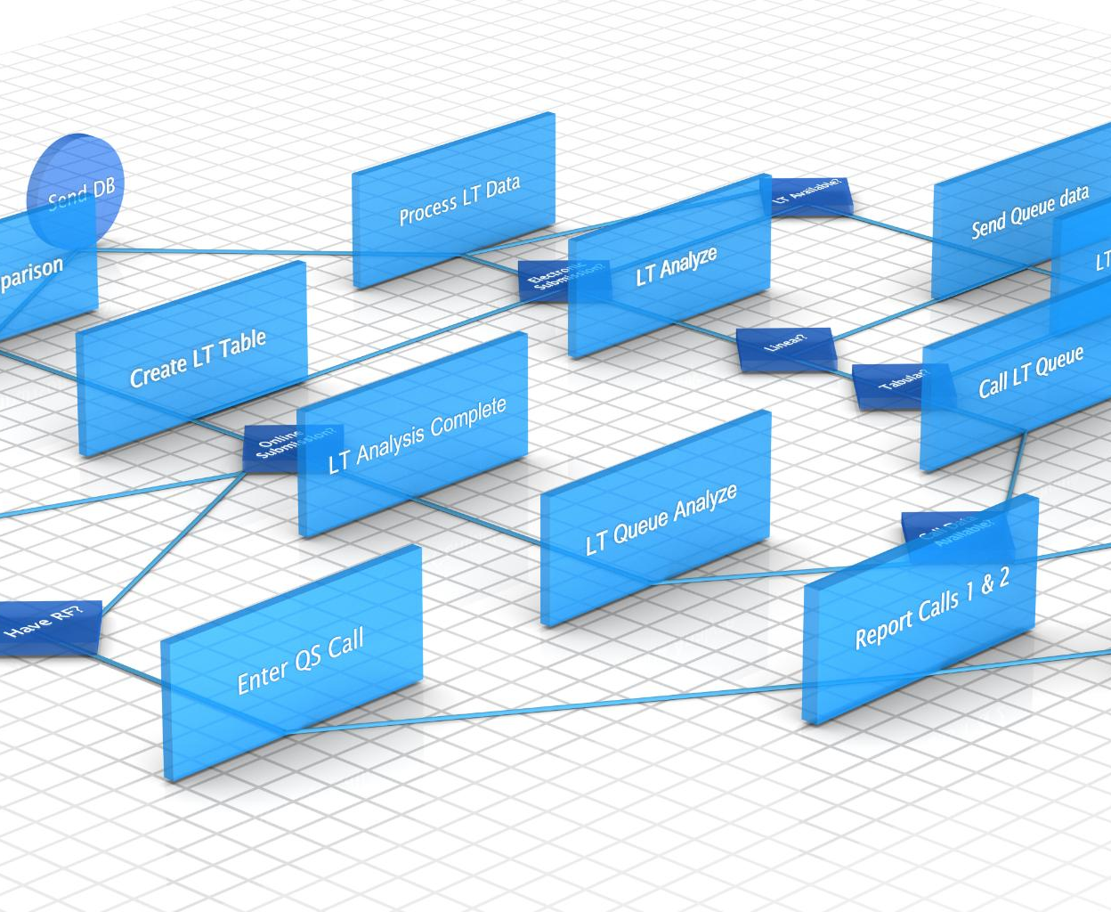
Unified Architecture for Streamlined Onboarding
Cohesive System Design
A unified architecture minimizes complexity, enabling clearer comprehension for new developers.
Facilitated Onboarding
Streamlined design accelerates new developer onboarding and boosts early productivity.
Notes:
--- A cohesive system design reduces complexity, making it easier for new developers to understand and contribute effectively. Image source: Microsoft 365 content library

Slide 27

Reduced Onboarding Time for New Developers
Clear Architecture Design
A well-defined architecture guides new developers, reducing confusion and accelerating project understanding.
Comprehensive Documentation
Thorough documentation provides essential knowledge, enabling faster onboarding and effective contribution.
Notes:
--- Clear architecture and documentation help minimize the time required for new team members to become productive. Image source: Microsoft 365 content library

Slide 28

Improved Maintainability and Codebase Consistency
Consistent Coding Standards
Applying uniform coding standards ensures clarity and reduces errors across the codebase.
Modular Design Benefits
Modular code structure simplifies updates, testing, and collaboration among developers.
Reduction of Technical Debt
Maintaining code consistency helps prevent accumulation of technical debt over time.
Notes:
--- Consistent coding standards and modular design promote maintainability and reduce technical debt over time. Image source: Microsoft 365 content library

Slide 29

Enhanced Security Through Centralized Standards
Centralized Security Protocols
Centralizing security protocols enforces uniform policies across all systems, minimizing security gaps.
Reduced Vulnerabilities
Adhering to strict security standards helps reduce potential vulnerabilities and enhances overall protection.
Notes:
--- Centralizing security protocols ensures that all components adhere to strict policies, reducing vulnerabilities. Image source: Microsoft 365 content library

Slide 30
Security and Compliance
Notes:
Focuses on authentication, data access control, and regulatory compliance measures embedded within the system.

Slide 31

JWT-Based Authentication and Multi-Tenancy Controls
JWT for Secure Sessions
JSON Web Tokens provide secure and stateless authentication for user sessions.
Multi-Tenancy Support
System supports multiple tenants with isolated and secure data access for each.
Notes:
--- Authentication uses JSON Web Tokens to secure sessions while supporting multiple tenants with isolated data access. Image source: Microsoft 365 content library

Slide 32

PostgreSQL RLS for Fine-Grained Data Access
Row-Level Security Concept
Row-Level Security enables control over who can access specific rows within database tables.
Data Access Restriction
RLS enforces fine-grained rules to restrict data access, improving database security significantly.
Notes:
--- Row-Level Security in PostgreSQL enforces precise access restrictions at the database level, enhancing data protection. Image source: Microsoft 365 content library

Slide 33

Compliance with Cambodian Data Protection Regulations
Legal Compliance
The system adheres strictly to Cambodia's national data privacy and security laws ensuring lawful data management.
Personal Data Security
Robust security measures protect personal information from unauthorized access in compliance with Cambodian regulations.
Notes:
--- The system is designed to comply with national laws governing personal data privacy and security in Cambodia. Image source: Microsoft 365 content library

Slide 34
Performance and Scalability
Notes:
Examines infrastructure choices and techniques applied to ensure system performance and ability to scale with demand.

Slide 35

Load Balancing and Horizontal Scaling for APIs
Role of Load Balancers
Load balancers distribute incoming API requests evenly across multiple servers to prevent overload and ensure high availability.
Horizontal Scaling Benefits
Horizontal scaling adds more servers to handle increased API demand, improving performance during peak usage times.
Notes:
--- APIs utilize load balancers and can scale horizontally to maintain responsiveness during peak usage. Image source: Microsoft 365 content library

Slide 36

Efficient Caching and Data Synchronization
Strategic Caching Benefits
Caching reduces data access latency, significantly improving retrieval speed and system performance.
Data Synchronization Importance
Synchronization maintains consistency and accuracy of data across multiple system components.
Notes:
--- Strategic caching improves data retrieval times, while synchronization ensures data consistency across components. Image source: Microsoft 365 content library

Slide 37

Monitoring and Alerting for Uptime Assurance
Early Issue Detection
Monitoring systems identify potential issues promptly to prevent downtime and service interruptions.
High Availability Maintenance
Alerting enables quick response, ensuring systems remain operational and reliable for users.
Notes:
--- Comprehensive monitoring and alert systems detect issues early, helping maintain high availability and reliability. Image source: Microsoft 365 content library

Slide 38
Integration and Extensibility
Notes:
Highlights modular design enabling integration with third-party services and planned support for future enhancements.

Slide 39

Modular Components for Easy System Integration
Modular Design Benefits
Modular components simplify system integration and enhance adaptability to new requirements.
Easy Integration
The platform supports seamless integration of different modules to build cohesive systems.
Flexibility and Adaptability
Modular architecture enables quick adaptation to evolving business and technical needs.
Notes:
--- The platform is built with modular components allowing easy integration and flexibility to adapt to changing requirements. Image source: Microsoft 365 content library

Slide 40

APIs for Third-Party Service Interoperability
Role of APIs
APIs enable seamless communication between different software systems and third-party services.
Expanding Platform Capabilities
Interoperability through APIs extends platform features by integrating external services effectively.
Notes:
--- Well-defined APIs facilitate interoperability with external systems and services to expand platform capabilities. Image source: Microsoft 365 content library

Slide 41
Planned Support for Future Modules and Enhancements
Scalable Architecture
The system architecture is designed to scale seamlessly to accommodate new modules and features.
Future Growth Support
Supports addition of new functionalities without disrupting existing operations.
Enhancement Flexibility
Allows enhancements to be implemented efficiently ensuring continuous improvement.
Notes:
--- The architecture anticipates future growth by supporting the addition of new modules and features without disruption. Image source: Microsoft 365 content library

Slide 42
Conclusion
Robust System Architecture
The system architecture ensures reliability and strong performance to support population management needs.
Security and Data Protection
Security measures safeguard sensitive population data against unauthorized access and breaches.
Scalability for Future Growth
The platform is designed to scale easily to accommodate Cambodia’s growing population management requirements.
Supporting National Goals
The system aligns with Cambodia’s objectives for effective and efficient population management.
Notes:
The Population Management System architecture is a robust, secure, and scalable platform designed to support Cambodia's national population management goals effectively and efficiently.

